Slide 1
Machine Learning- Examples of Various Learning Paradigms, Perspectives and Issues

Slide 2
Supervised learning is a technique in which we teach or train the machine using data that is well-labeled.
As kids we all needed guidance to solve math problems.
Our teachers helped us understand what addition is and how it is done.
Similarly, you can think of supervised learning as a type of Machine Learning that involves a guide.
The labeled data set is the teacher that will train you to understand patterns in the data.
The labeled data set is the training data set.

Slide 3
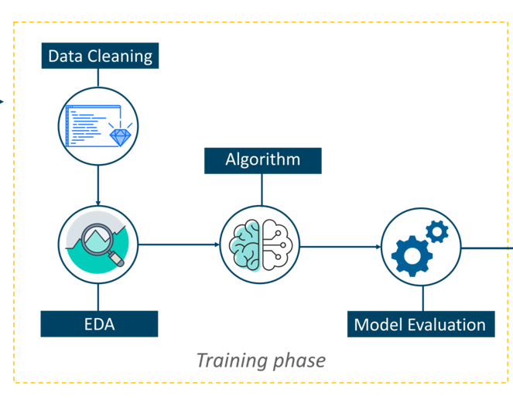
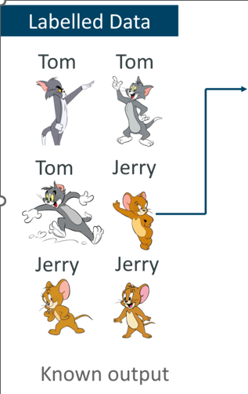
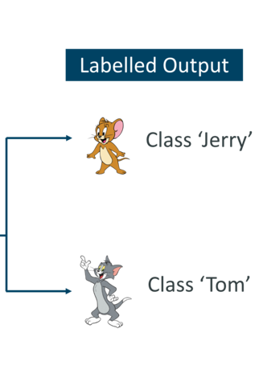
Supervised learning

Slide 4
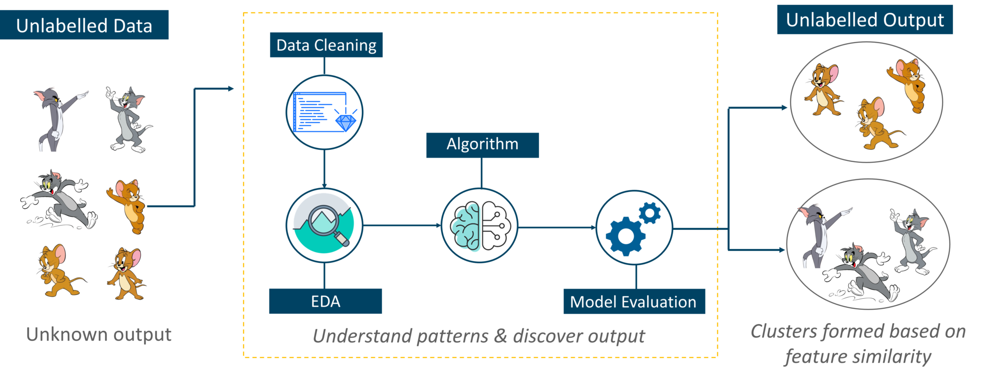
Unsupervised learning involves training by using unlabeled data and allowing the model to act on that information without guidance.
Think of unsupervised learning as a smart kid that learns without any guidance.
In this type of Machine Learning, the model is not fed with labeled data, as in the model has no clue that ‘this image is Tom and this is Jerry’,
it figures out patterns and the differences between Tom and Jerry on its own by taking in tons of data.

Slide 5
Reinforcement Learning is a part of Machine learning where an agent is put in an environment and he learns to behave in this environment by performing certain actions and observing the rewards which it gets from those actions.
Imagine that you were dropped off at an isolated island! What would you do?
Panic?
Yes, of course, initially we all would.
But as time passes by, you will learn how to live on the island.
You will explore the environment, understand the climate condition, the type of food that grows there, the dangers of the island, etc.
This is exactly how Reinforcement Learning works, it involves an Agent (you, stuck on the island) that is put in an unknown environment (island), where he must learn by observing and performing actions that result in rewards.
Reinforcement Learning is mainly used in advanced Machine Learning areas such as self-driving cars, AplhaGo, etc.

Slide 6


Slide 7
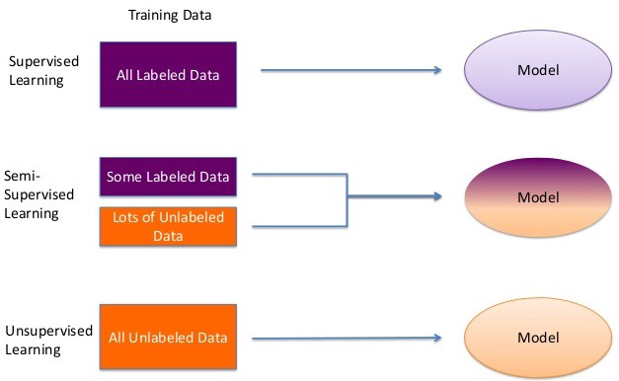
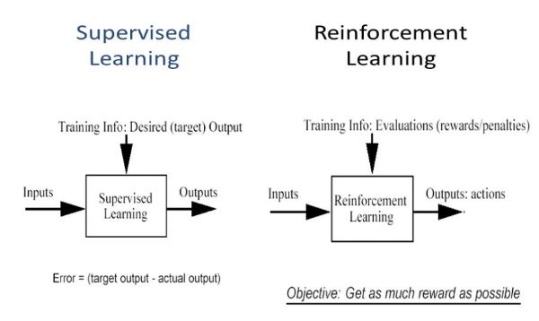
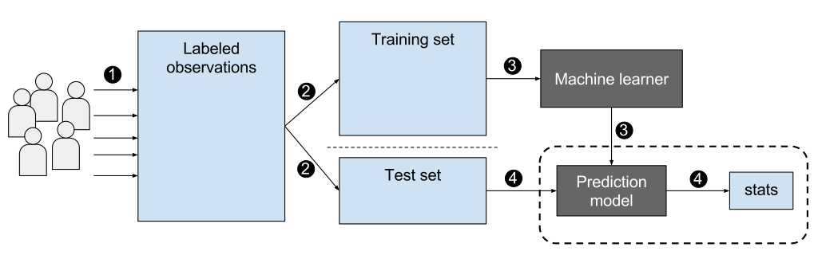

Slide 8
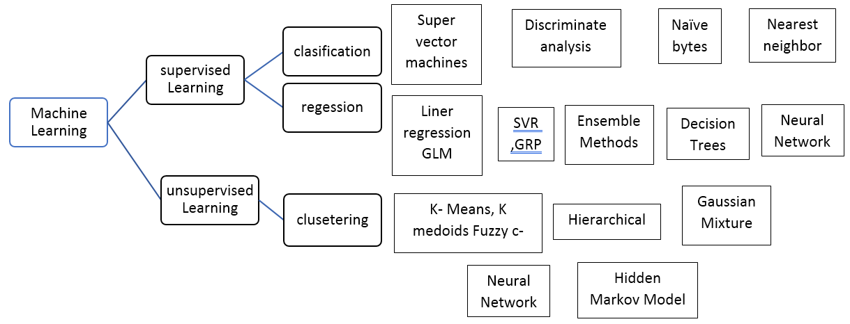

Slide 9
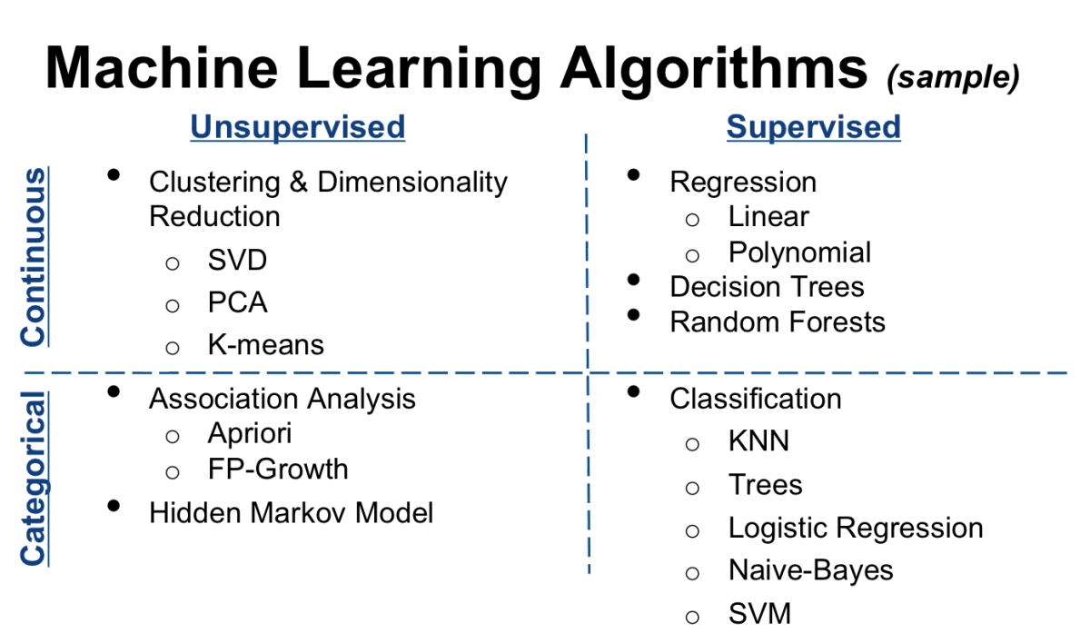

Slide 10
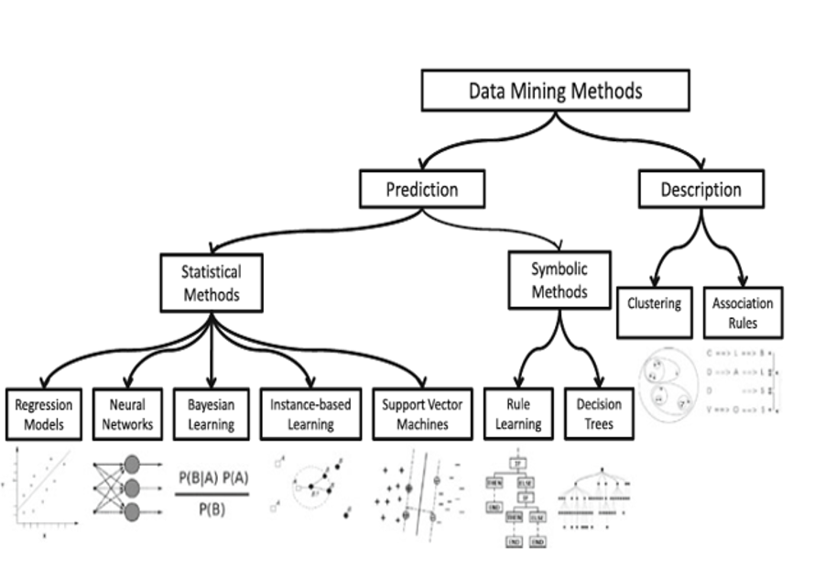

Slide 11
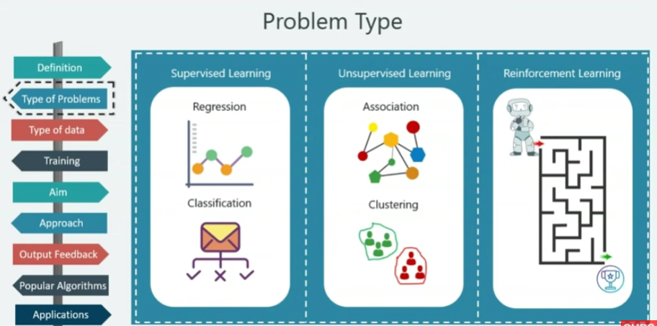

Slide 12
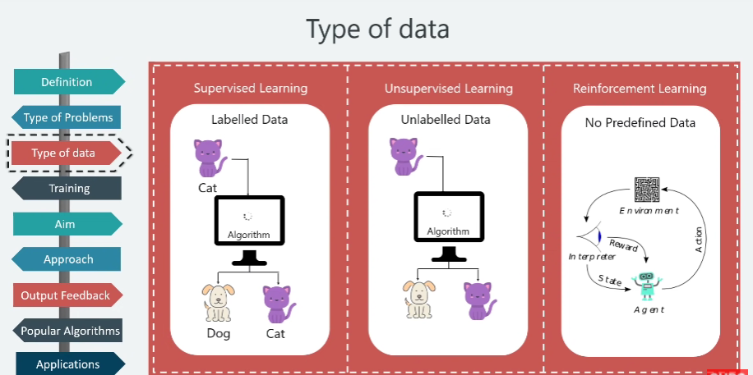

Slide 13
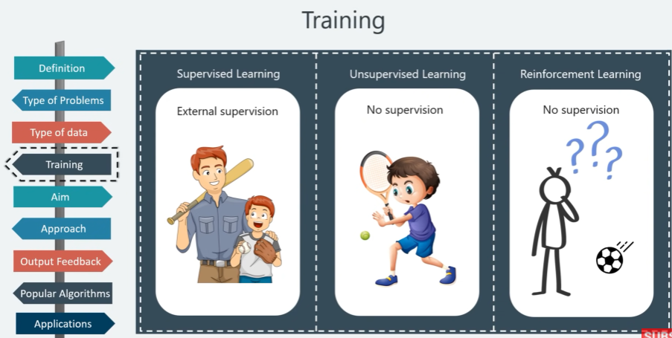

Slide 14
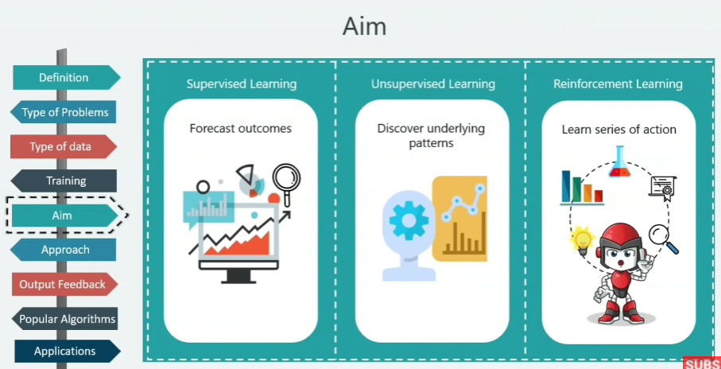

Slide 15
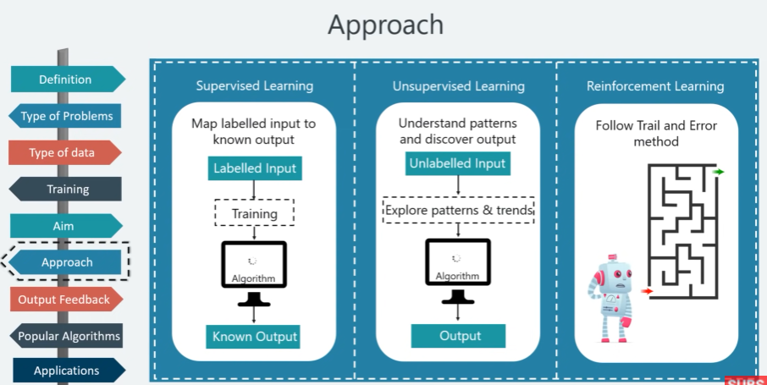

Slide 16
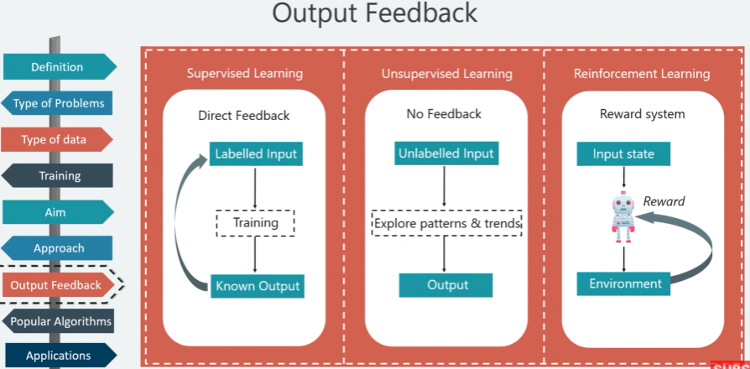

Slide 17
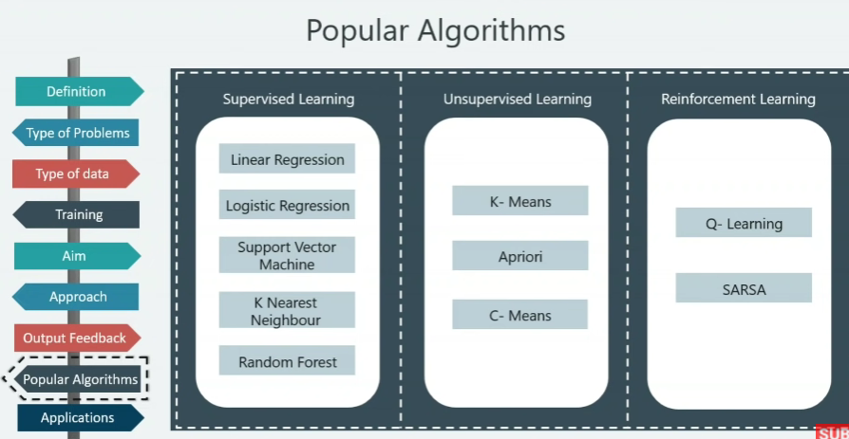

Slide 18
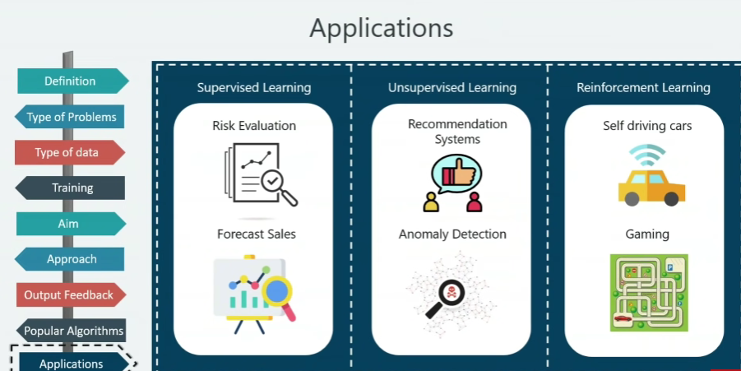

Slide 19
Machine Learning Techniques
classification: predict class from observations
clustering: group observations into meaningful” groups
Regression (prediction): predict value from observations

Slide 20
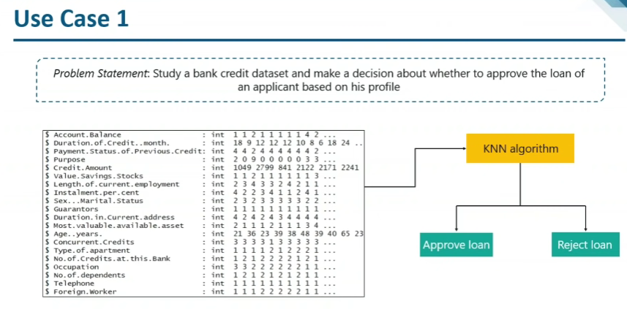

Slide 21
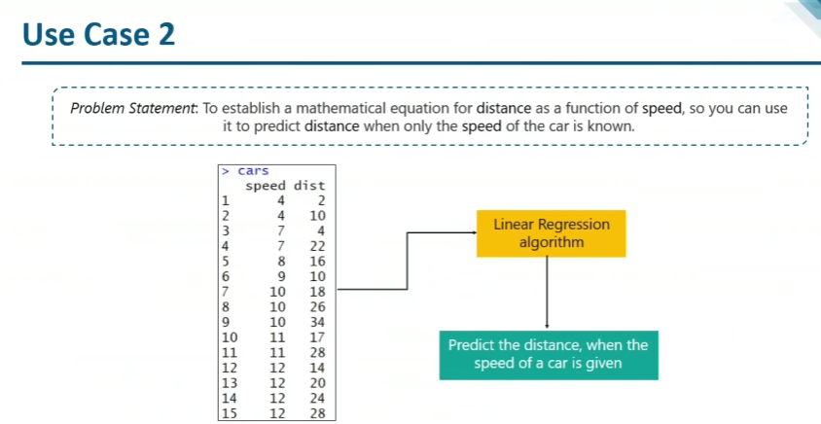

Slide 22
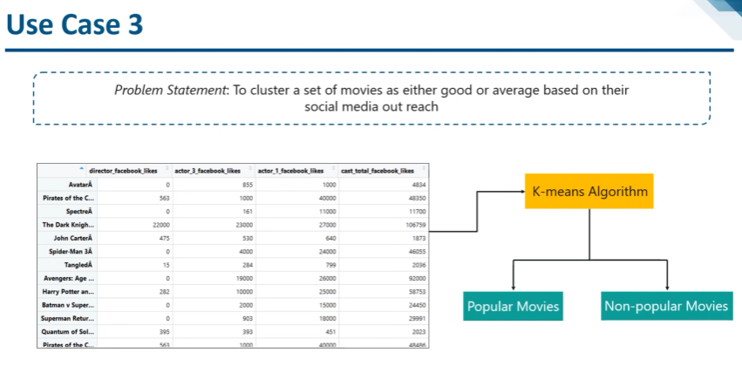

Slide 23
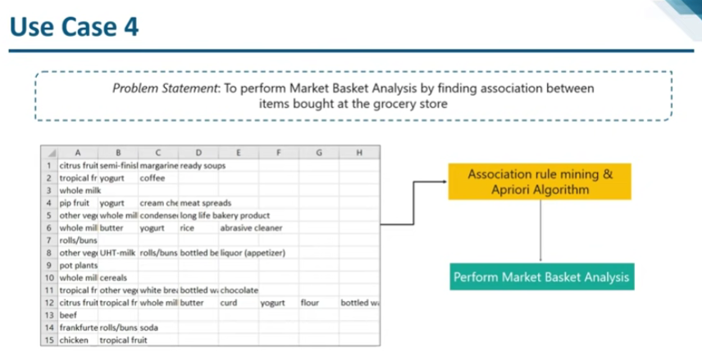

Slide 24
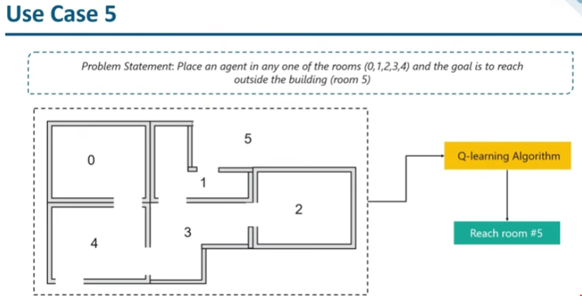

Slide 25
Perspective & Issues in Machine Learning
Perspective:
It involves searching a very large space of possible hypothesis to determine the one that best fits the observed data.

Slide 26
Perspective & Issues in Machine Learning
Which algorithm performs best for which types of problems & representation?
How much training data is sufficient?
Can prior knowledge be helpful even when it is only approximately correct?
How does number of training examples influence accuracy?
The best strategy for choosing a useful next training experience.
What specific function should the system attempt to learn?
How can learner automatically alter it’s representation to improve it’s ability to represent and learn the target function?

Slide 27
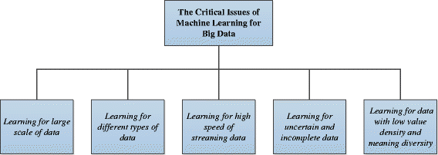

Slide 28
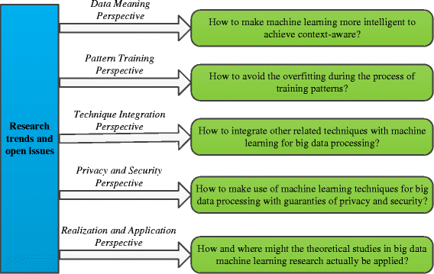

Slide 29
Measuring Learning Performance

Slide 30
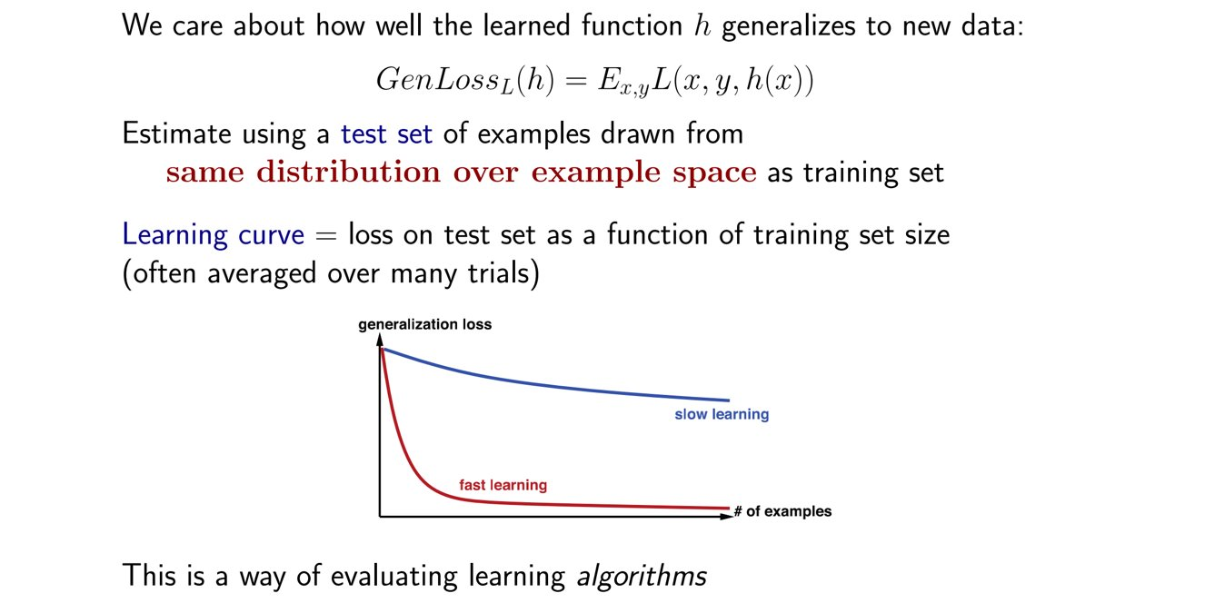
Performance measurement​

Slide 31
Performance measurement​
Classification Metrics (accuracy, precision, recall, F1-score, ROC, AUC, …)
Regression Metrics (MSE, MAE)
Ranking Metrics (MRR, DCG, NDCG)
Statistical Metrics (Correlation)
Computer Vision Metrics (PSNR, SSIM, IoU)
NLP Metrics (Perplexity, BLEU score)
Deep Learning Related Metrics (Inception score, Frechet Inception distance)

Slide 32
Confusion Matrix
Confusion Matrix is not exactly a performance metric but sort of a basis on which other metrics evaluate the results,
Each cell in the confusion matrix represents an evaluation factor. Let’s understand these factors one by one.
True Positive(TP) signifies how many positive class samples your model predicted correctly.
True Negative(TN) signifies how many negative class samples your model predicted correctly.
False Positive(FP) signifies how many negative class samples your model predicted incorrectly. This factor represents Type-I error in statistical nomenclature. This error positioning in the confusion matrix depends on the choice of the null hypothesis.
False Negative(FN) signifies how many positive class samples your model predicted incorrectly. This factor represents Type-II error in statistical nomenclature. This error positioning in the confusion matrix also depends on the choice of the null hypothesis.

Slide 33
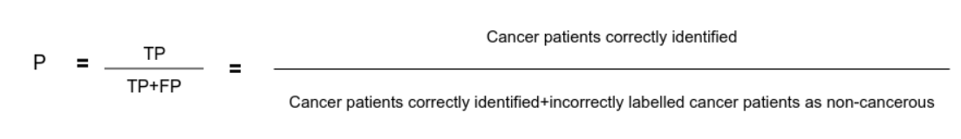
Precision
Precision is the ratio of true positives and total positives predicted:
0<P<1
The precision metric focuses on Type-I errors(FP). A Type-I error occurs when we reject a true null Hypothesis(H⁰).

Slide 34
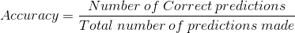
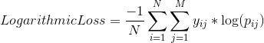
Classification Accuracy
It is the ratio of the number of correct predictions to the total number of input samples.
Logarithmic Loss
Logarithmic Loss or Log Loss, works by penalizing the false classifications. It works well for multi-class classification.
where,
y_ij, indicates whether sample i belongs to class j or not
p_ij, indicates the probability of sample i belonging to class j

Slide 35
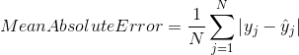
Mean Absolute Error
Mean Absolute Error is the average of the difference between the Original Values and the Predicted Values.
It gives us the measure of how far the predictions were from the actual output.
Mean Squared Error
Mean Squared Error(MSE) is quite similar to Mean Absolute Error, the only difference being that MSE takes the average of the square of the difference between the original values and the predicted values.

